Slide 1

Testing the Digital Frontier: Opportunities and Validity Trade-offs in Digital Quasi-Experiments
Johannes Boegershausen, Shangwen Yi, Yann Cornil, & David J. Hardisty
ESSEC University Seminar, March 9 2023

Slide 2
Online AB Testing
The average person spends 6 hours and 58 minutes looking at their screen each day doing internet-connected activities (We are Social 2022)
Researchers are keen test theories in online field studies
Online advertising platforms such as Facebook (Meta) and Google offer convenient tools

Slide 3
Digital Quasi Experiments (DQE)
“AB Testing” is an ambiguous term
DQE Definition: studies that are run in a naturalistic online environment and that aim to compare the effect of different stimuli (in particular ads) by using the A/B testing functionalities provided by digital platforms, such as Facebook or Google Ads
Distinct from:
Fully randomized controlled trials (RCTs) run in partnership with an organization
Holdout (or “lift”) tests – examine effect of advertisement exposure vs no exposure

Slide 4
DQE Example: Dread vs Savoring in Consumer Finance
Hardisty, D. J., & Weber, E. U. (2020). Impatience and savoring vs. dread: Asymmetries in anticipation explain consumer time preferences for positive vs. negative events. Journal of Consumer Psychology, 30(4), 598-613.
Study 1B: N (“reach”) = 90,076
Canadians ages 22-64
Research question: which is stronger, “dread” or “savoring”?
2x2 Design:
focus on Positive vs Negative
anticipation word Absent vs Present

Slide 5


DQE Example: Dread vs Savoring in Consumer Finance

Slide 6


DQE Example: Dread vs Savoring in Consumer Finance

Slide 7
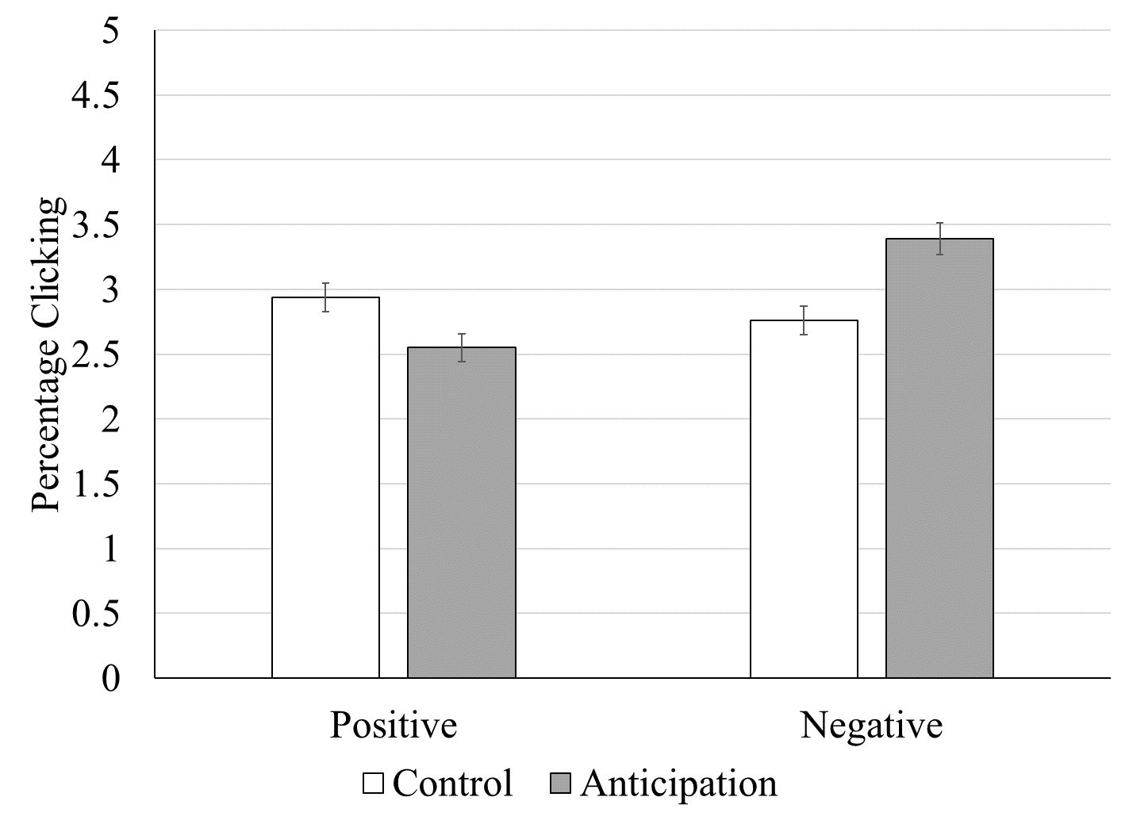
DQE Example: Dread vs Savoring in Consumer Finance
Interaction: b=-0.09, SE=0.02, Wald χ²(1)=20.35, p<.001
Notes:
The click-through rate on the negatively framed, anticipation focused advertisement (CTR=3.39%, n=21,840) was the highest, outperforming the positively framed, anticipation focused advertisement (CTR=2.55%, n=22,576), the negatively frame advertisement without the anticipation message (CTR=2.76%, n=22,732), and the positively framed advertisement without anticipation message (CTR=2.94%, n=22,928). A 2x2 logistic regression with contrast coding found a main effect of sign, b=-0.06, SE=0.02, Wald χ²(1)=8.43, p<.01, no main effect of anticipation message (vs control message), b=0.02, SE=0.02, Wald χ²(1)=0.72, p=.40, and a significant sign X anticipation interaction, b=-0.09, SE=0.02, Wald χ²(1)=20.35, p<.001. The interaction indicates that while the anticipation message improved CTR for the negatively-framed ad, it actually made the CTR worse for the positively-framed ad.
Follow-up pairwise comparisons revealed that the negative anticipation ad outperformed the positive anticipation ad, b=0.15, SE=0.03, Wald χ²(1)=27.45, p<.001, as well as the other two ads, both p<.01. In contrast, when anticipation was not emphasized, there was no difference between the positively framed ad and the negatively framed ad, b=0.03, SE=0.03, Wald χ²(1)=1.29, p=26.
Turning to cost-per-click, the negative anticipation ad (CPC=$0.24) outperformed the positive anticipation ad (CPC=$0.30), as well as the generic negative ad (CPC=$0.30) and the generic positive ad (CPC=$0.26).

Slide 8
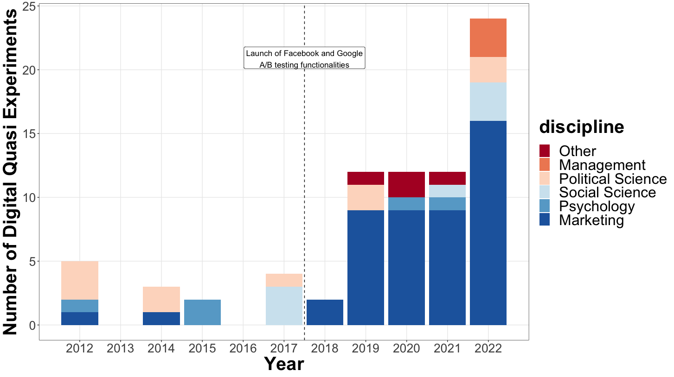
DIGITAL QUASI-EXPERIMENTS BY DISCIPLINE (2012-2022)
Notes:
The figure shows the number of digital quasi-experiments (DQE) organized by discipline mapped over time.

Slide 9
PREVALENCE OF THEORETICAL TOPICS (2012-2022)
Notes:
NOTE: Theoretical topics with at least 10% prevalence in the title, abstract, or keywords of either DQE or JCR are shown. The dashed line indicates equal proportions in DQE and JCR.

Slide 10
Digital Quasi Experiments (DQE): Validity Tradeoffs
The benefits of DQE are clear: relatively quick, relatively inexpensive, ecologically-valid field data.
But: platform documentation is ambiguous and sometimes misleading, hiding a critical flaw for researchers: “divergent delivery” compromises internal validity, so we cannot make clean causal inferences.
DQE cannot replace a fully-random experiment!!!
DQE should be used as a “proof of concept” or case example (similar to many secondary data sources), rather than a clean test of theory
We offer a series of recommendations informed by a systematic review of current practices in 76 DQE published so far

Slide 11
DQE: Review of Current Practice
CTR is a dependent variable in 97% of studies, yet the exact operationalization of CTR varies significantly:
Numerator: “total clicks” vs “unique clicks”
Denominator: “reach” vs “impressions”
Median sample size per condition
38,532 ad exposures (among the 44 DQE that report “impressions” or “views”)
18,067 users exposed to the content (among the 25 DQE that report “reach”).
57.9% mislabeled DQE as a (true) experiment
21.1% discussed the lack of true randomization

Slide 12

DQE: Key differences to conventional experiments & recommendations for researchers
1
2
3
4
Internal Validity
Ecological and External Validity
Transparency
Ethics

Slide 13

Internal Validity

Slide 14
Key difference to conventional experiments
DQE are not true experiments: researchers relinquish control over randomization to the digital platforms, which use a bidding process and targeting algorithms to optimize ad delivery, resulting in “divergent delivery” across conditions.
Participants may differ between conditions in observable ways (gender, age, etc.) or unobservable ways (extroversion, interests, etc.). They also may be exposed a different number of times across conditions.
Users may “like/share/comment”, which creates endogeneity issue
Example: control product ad vs an environmental product ad If the environmental ad performs better, was it more effective overall, or was it simply targeted to environmentalists, and perhaps it is actually less effective overall
In short, DQE do not test “A” vs “B”. They test “A+optimization+reactions” vs “B+optimization+reactions”.

Slide 15
Recommendations for Researchers
Correctly characterize the study by explicitly acknowledging the non-random delivery of treatments (i.e., divergent delivery)
Disclose optimization objectives (i.e., link clicks, reach)
Minimize differences across ads (e.g., design, placement)
Engage in stimulus sampling and close replications
Report impression-to-reach ratio across conditions and sample ratio mismatch to inform readers of the divergent delivery
Consider optimizing on reach (vs. on clicks), at the expense of ecological validity
Consider advanced approaches to manipulate audience quality (e.g., random bidding process), at the expense of ecological validity

Slide 16
Ecological and External Validity

Slide 17
Key difference to conventional experiments
DQE allow studying “real” conversion behaviors across the online funnel (e.g., ad clicks, page views, app installs, donations, purchases) among large and diverse populations.

Slide 18
Recommendations for Researchers
Study actual marketplace offerings, with realistic advertising campaigns
Target business-relevant populations
Propose a business-relevant interpretation of the findings (e.g., is the clickthrough rate high enough or the cost-per-click low enough to justify a large-scale advertising campaign?)
If possible, study non-WEIRD populations

Slide 19
Transparency

Slide 20
Key difference to conventional experiments
There are multiple possible operationalizations for the computation of the clickthrough rate, the key dependent variable in DQE.

Slide 21
Recommendations for Researchers
Preregister focal analyses
Disclose all potential metrics used in the computation of the clickthrough rate (unique/total clicks, impression, reach)
Disclose a) campaign duration, b) budget, c) optimization type, d) sampling strategy, and e) user reactions (likes, comments)

Slide 22
Ethics

Slide 23
Key difference to conventional experiments
There is no informed consent.
Targeting possibilities are governed by business ethics rather than academic ethics.

Slide 24
Recommendations for Researchers
Provide a debrief and links related to the ad upon clicking on the ad
Be cognizant of the difficulty of studying underrepresented populations (not everyone uses Facebook!)

Slide 25

Summary & Conclusions
DQE offer high ecological validity but lower internal validity
DQE should be used as a complement to, rather than a replacement for, lab-based experiments
With careful design and reporting, DQE can be a useful tool in the modern consumer research toolbox

Slide 26

Thank you

